Slide 1

CVR COLLEGE OF ENGINEERING
Department of CSE(AI&ML)
Real-Time / Field-Based Research Project -2
HOSPITAL CHATBOT
Under the guidance of Dr.H.N.Lakshmi
Professor & Associate Dean
Team Members:
Darmayagari Akshaya – 23B81A6667
Chunduru Niveditha – 23B81A6695
Domala Poojitha – 23B81A6698

Slide 2
Outline
Abstract
Introduction
Problem definition
Existing System
Objectives-features
Hardware software requirements
Methodology/Techniques(System architecture)
Functional & nonfunctional requirements
UML Diagrams
Implementation Methodology-Sample Code
Screenshots
Conclusion
References

Slide 3
Abstract
1.Java Swing app for hospital appointment booking, viewing, and cancellation.
2.Supports doctor selection, time slot viewing, and patient detail entry.
3.Validates and cancels only existing appointments.
4.Filters appointments by selected doctor and date.
5.Interactive UI with buttons, dropdowns, and text fields.

Slide 4
Introduction
1.Hospital Chatbot is a Java Swing app for managing hospital appointments.
2.Patients use a chatbot to view doctors, book, modify, or cancel appointments with real-time updates.
3.Supports multiple hospitals with specialized doctors and slot availability checks.
4.Generates an on-screen confirmation letter after booking.
5.UI features color-coded themes, clean layouts, and an intuitive design.

Slide 5
Problem definition
1.Manual hospital appointment management is time-consuming.
2.Patients struggle to access doctor details easily.
3.Rural patients face challenges traveling long distances for appointments.
4.There's a need for an interactive system to book, modify, and cancel appointments.
5.Manual processes are prone to human errors.
6.Inefficient scheduling causes long patient waiting times.
7.Lack of real-time updates results in double bookings and confusion.

Slide 6
Existing System
1.Manual appointment handling leads to booking delays and errors.
2.Doctor info is not organized by hospital or specialty.
3.Online systems rely on stable internet, which remote areas may lack.
4.No easy option to cancel or modify appointments.
5.Patients lack confirmation and real-time availability updates.

Slide 7
Objectives-features
1.Chatbot simplifies booking, modifying, and canceling hospital appointments.
2.Displays doctors by hospital and specialty for easy selection.
3.Real-time system enables instant appointment management.
4.Generates confirmation letter with verified details after booking.
5.Supports hospital-specific cancellation policies.

Slide 8
Software Requirements
Languages:
Java (JDK)
Tools/IDEs:
Eclipse / IntelliJ IDEA (IDE)
Swing (for GUI development)
Operating System:
Windows / Linux / MacOS

Slide 9
Hardware Requirements
RAM:
Minimum: 4GB
Recommended: 8GB
Disk Space:
Minimum: 500GB
Processor:
Minimum: 1.5 GHz
Recommended: 2.5 GHz

Slide 10
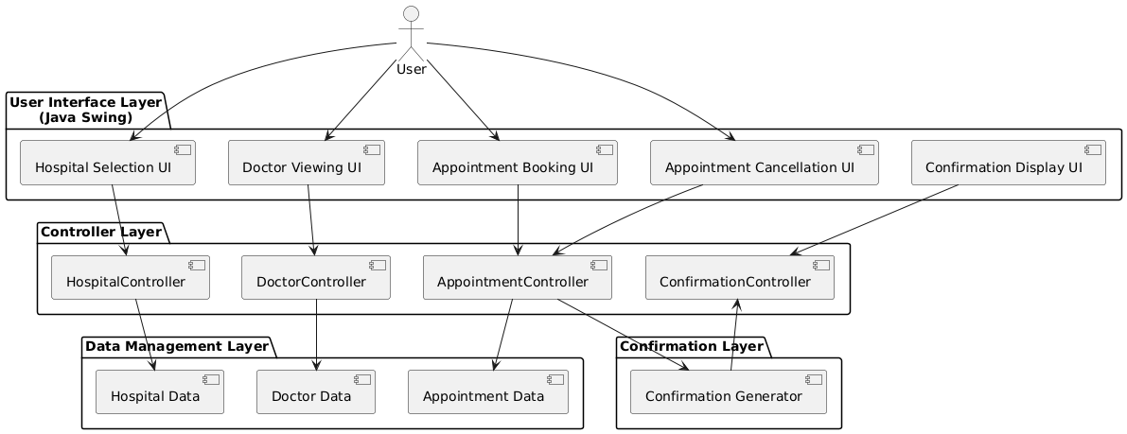
System architecture

Slide 11
Functional & nonfunctional requirements
Functional Requirements:
1.Easy booking, modification, and cancellation of appointments.
2.Categorized doctor list by hospital and specialty.
3.Real-time appointment updates.
4.Auto-generated confirmation letters after booking.
5.Hospital-specific cancellation rules.
Non-Functional Requirements:
Fast, secure, and user-friendly interface.

Slide 12
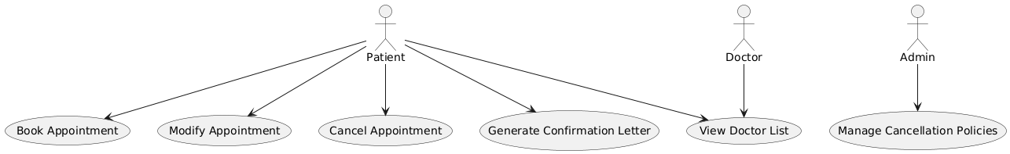
UML Diagrams
Use Case Diagram

Slide 13
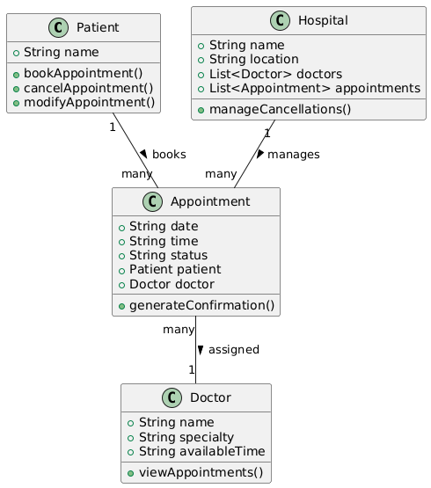
Class Diagram

Slide 14
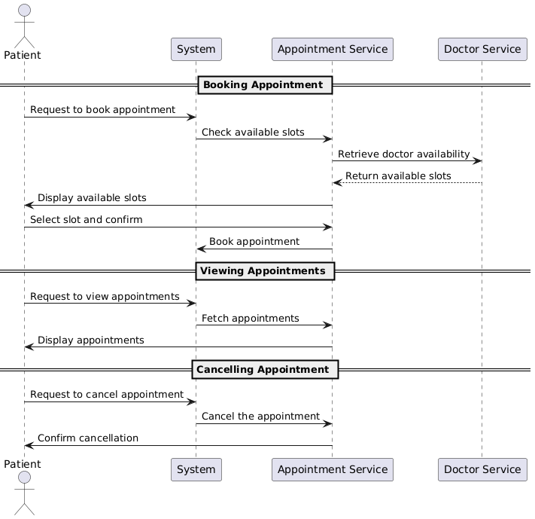
Sequence Diagram

Slide 15
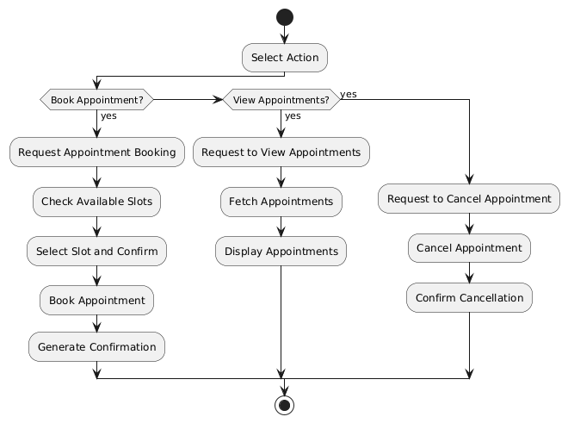
Activity Diagram

Slide 16
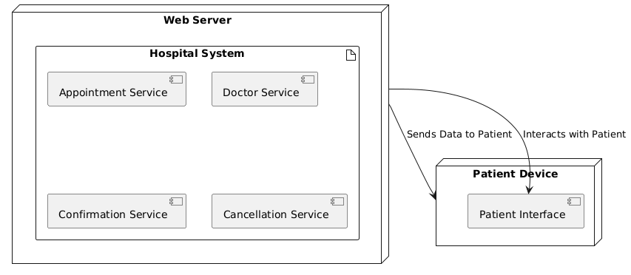
Deployment Diagram

Slide 17
Implementation Methodology along with Sample Code
1.Data Structure: Maps store hospitals, doctors, and appointment bookings.
2.GUI Setup: Swing creates the main window with buttons for selecting hospitals and managing appointments.
3.Doctor Interaction: Displays available doctors and time slots for booking or cancellation.
4.Appointment Management: Allows booking/cancellation with date validation and time-slot handling.
5.Confirmation: Displays a confirmation letter with details, styled with Swing.

Slide 18
Some important functions of the code are:
1)Viewing doctors in hospital:
private static void viewDoctors(String hospital) {
JFrame doctorsFrame = new JFrame("Available Doctors at " + hospital);
doctorsFrame.setSize(400, 300);
doctorsFrame.setLayout(new BorderLayout());
JTextArea doctorsList = new JTextArea();
doctorsList.setEditable(false);
StringBuilder sb = new StringBuilder("Doctors at " + hospital + ":\n\n");
for (String doctor : hospitalDoctors.get(hospital)) {
sb.append("- ").append(doctor).append("\n");
}
doctorsList.setText(sb.toString());
doctorsList.setFont(new Font("Courier New", Font.PLAIN, 14));
doctorsFrame.add(new JScrollPane(doctorsList), BorderLayout.CENTER);
doctorsFrame.setVisible(true);
}

Slide 19
2)Appointment booking::::
private static void bookAppointment(String hospital) {
JFrame bookingFrame = new JFrame("Book Appointment at " + hospital);
bookingFrame.setSize(400, 400);
bookingFrame.setLayout(new GridLayout(8, 1));
JComboBox<String> doctorDropdown = new JComboBox<>(hospitalDoctors.get(hospital));
JComboBox<String> timeSlotDropdown = new JComboBox<>(timeSlots);
JSpinner dateSpinner = new JSpinner(new SpinnerDateModel());
JSpinner.DateEditor dateEditor = new JSpinner.DateEditor(dateSpinner, "yyyy-MM-dd");
dateSpinner.setEditor(dateEditor);
JTextField nameField = new JTextField();
JButton bookButton = new JButton("Book");
JLabel statusLabel = new JLabel();
bookButton.addActionListener(e -> {
String doctor = (String) doctorDropdown.getSelectedItem();
String timeSlot = (String) timeSlotDropdown.getSelectedItem();
String name = nameField.getText().trim();
if (name.isEmpty()) {
statusLabel.setText("Invalid name! Please enter your name.");
return;
}

Slide 20
Date selectedDate = (Date) dateSpinner.getValue();
SimpleDateFormat dateFormat = new SimpleDateFormat("yyyy-MM-dd");
String dateString = dateFormat.format(selectedDate);
Map<String, Map<String, Map<String, String>>> hospitalAppointments = appointments.get(hospital);
Map<String, Map<String, String>> doctorAppointments = hospitalAppointments.getOrDefault(doctor, new HashMap<>());
Map<String, String> dateAppointments = doctorAppointments.getOrDefault(dateString, new HashMap<>());
if (dateAppointments.containsKey(timeSlot)) {
statusLabel.setText("Time slot already booked on this date!");
} else { dateAppointments.put(timeSlot, name);
doctorAppointments.put(dateString, dateAppointments);
hospitalAppointments.put(doctor, doctorAppointments);
appointments.put(hospital, hospitalAppointments);
statusLabel.setText("Appointment booked successfully!");
showAppointmentLetter(name, hospital, doctor, timeSlot, dateString);
}});
bookingFrame.add(doctorDropdown);
bookingFrame.add(dateSpinner);
bookingFrame.add(timeSlotDropdown);
bookingFrame.add(nameField);
bookingFrame.add(bookButton);
bookingFrame.add(statusLabel);
bookingFrame.setVisible(true);
}

Slide 21
3)Cancelling appointment:
private static void cancelAppointment(String hospital) {
JFrame cancelFrame = new JFrame("Cancel Appointment at " + hospital);
cancelFrame.setSize(400, 300);
cancelFrame.setLayout(new GridLayout(7, 1));
JComboBox<String> doctorDropdown = new JComboBox<>(hospitalDoctors.get(hospital));
JComboBox<String> timeSlotDropdown = new JComboBox<>(timeSlots);
JSpinner dateSpinner = new JSpinner(new SpinnerDateModel());
JSpinner.DateEditor dateEditor = new JSpinner.DateEditor(dateSpinner, "yyyy-MM-dd");
dateSpinner.setEditor(dateEditor);
JButton cancelButton = new JButton("Cancel Appointment");
JLabel statusLabel = new JLabel();
cancelButton.addActionListener(e -> {
String doctor = (String) doctorDropdown.getSelectedItem();
String timeSlot = (String) timeSlotDropdown.getSelectedItem();
Date selectedDate = (Date) dateSpinner.getValue();
SimpleDateFormat dateFormat = new SimpleDateFormat("yyyy-MM-dd");
String dateString = dateFormat.format(selectedDate);
Map<String, Map<String, Map<String, String>>> hospitalAppointments = appointments.get(hospital);

Slide 22
Map<String, String> dateAppointments = doctorAppointments.getOrDefault(dateString, new HashMap<>());
if (dateAppointments.containsKey(timeSlot)) {
dateAppointments.remove(timeSlot);
if (dateAppointments.isEmpty()) {
doctorAppointments.remove(dateString);
}
statusLabel.setText("Appointment canceled successfully!");
} else {
statusLabel.setText("No appointment found at the selected time slot on this date!");
}
});
cancelFrame.add(doctorDropdown);
cancelFrame.add(dateSpinner);
cancelFrame.add(timeSlotDropdown);
cancelFrame.add(cancelButton);
cancelFrame.add(statusLabel);
cancelFrame.setVisible(true);
}

Slide 23
4)Displaying appointment letter:
private static void showAppointmentLetter(String name, String hospital, String doctor, String timeSlot, String dateString) {
JFrame letterFrame = new JFrame("Appointment Confirmation");
letterFrame.setSize(400, 300);
letterFrame.setLayout(new BorderLayout());
JTextArea letterArea = new JTextArea();
letterArea.setEditable(false);
String appointmentDetails = "Appointment Confirmation\n\n" +
"Hospital: " + hospital + "\n" +
"Doctor: " + doctor + "\n" +
"Date: " + dateString + "\n" +
"Time Slot: " + timeSlot + "\n\n" +
"Patient: " + name + "\n\n" +
"Thank you for choosing our hospital.";
letterArea.setText(appointmentDetails);
letterArea.setFont(new Font("Courier New", Font.PLAIN, 14));
letterFrame.add(new JScrollPane(letterArea), BorderLayout.CENTER);
letterFrame.setVisible(true);
}

Slide 24
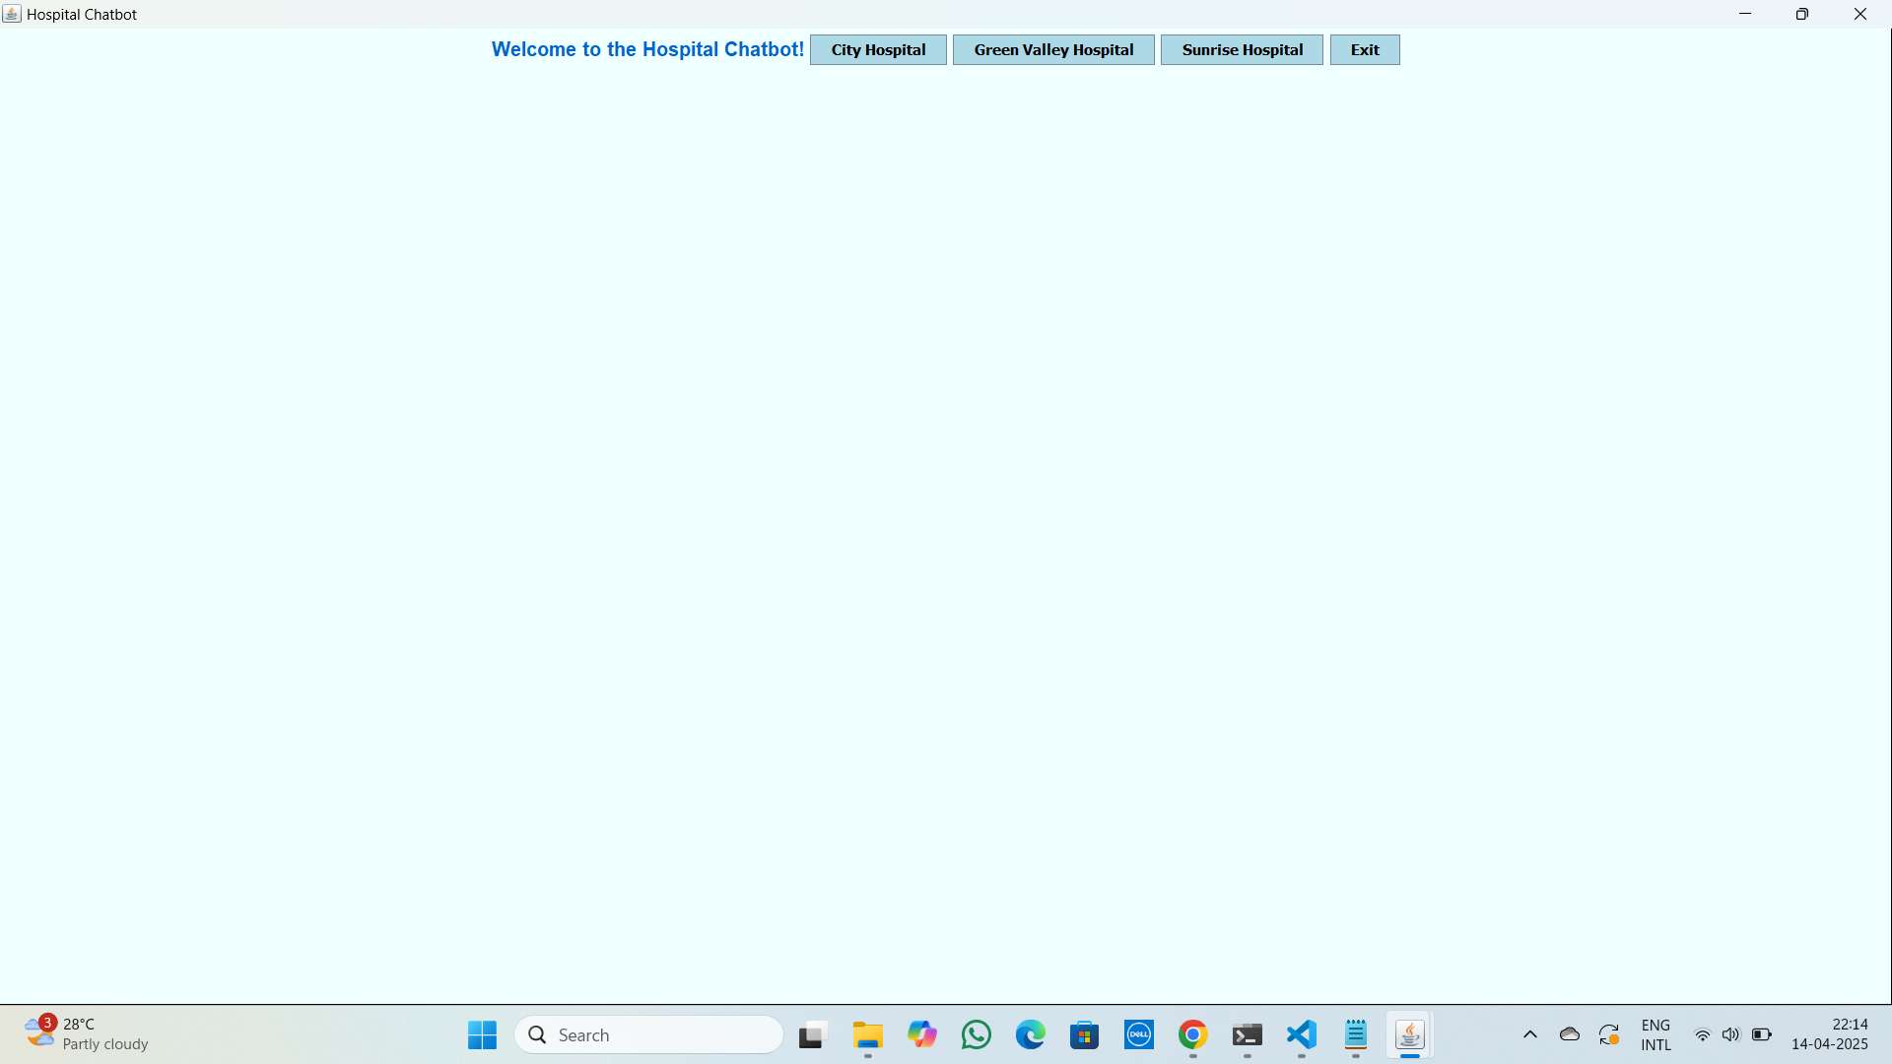
Screenshots

Slide 25
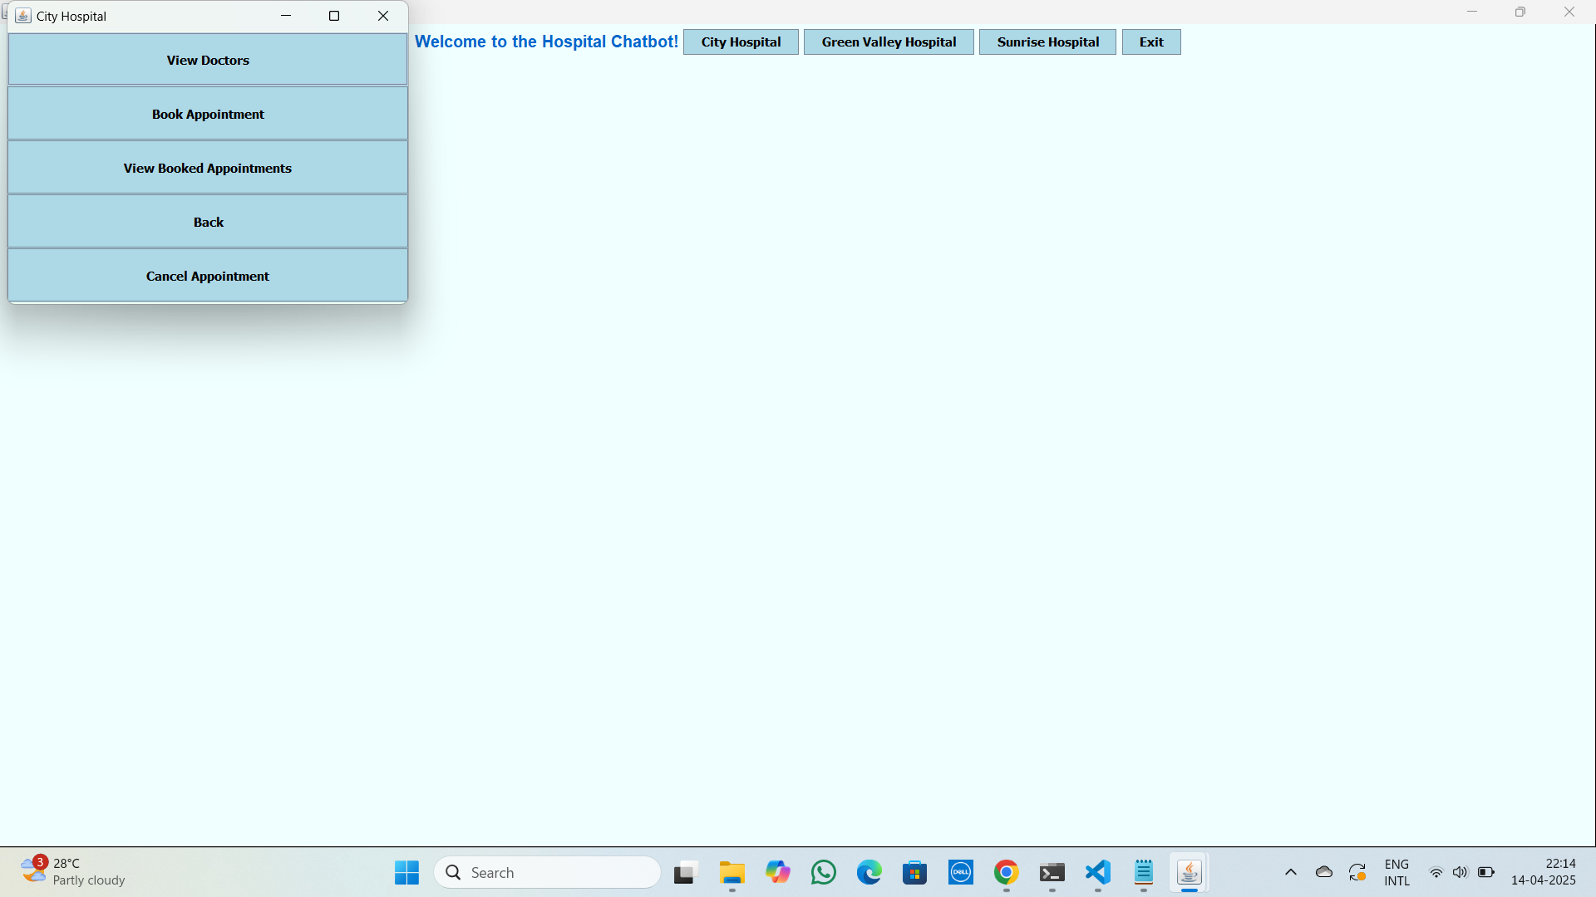

Slide 26
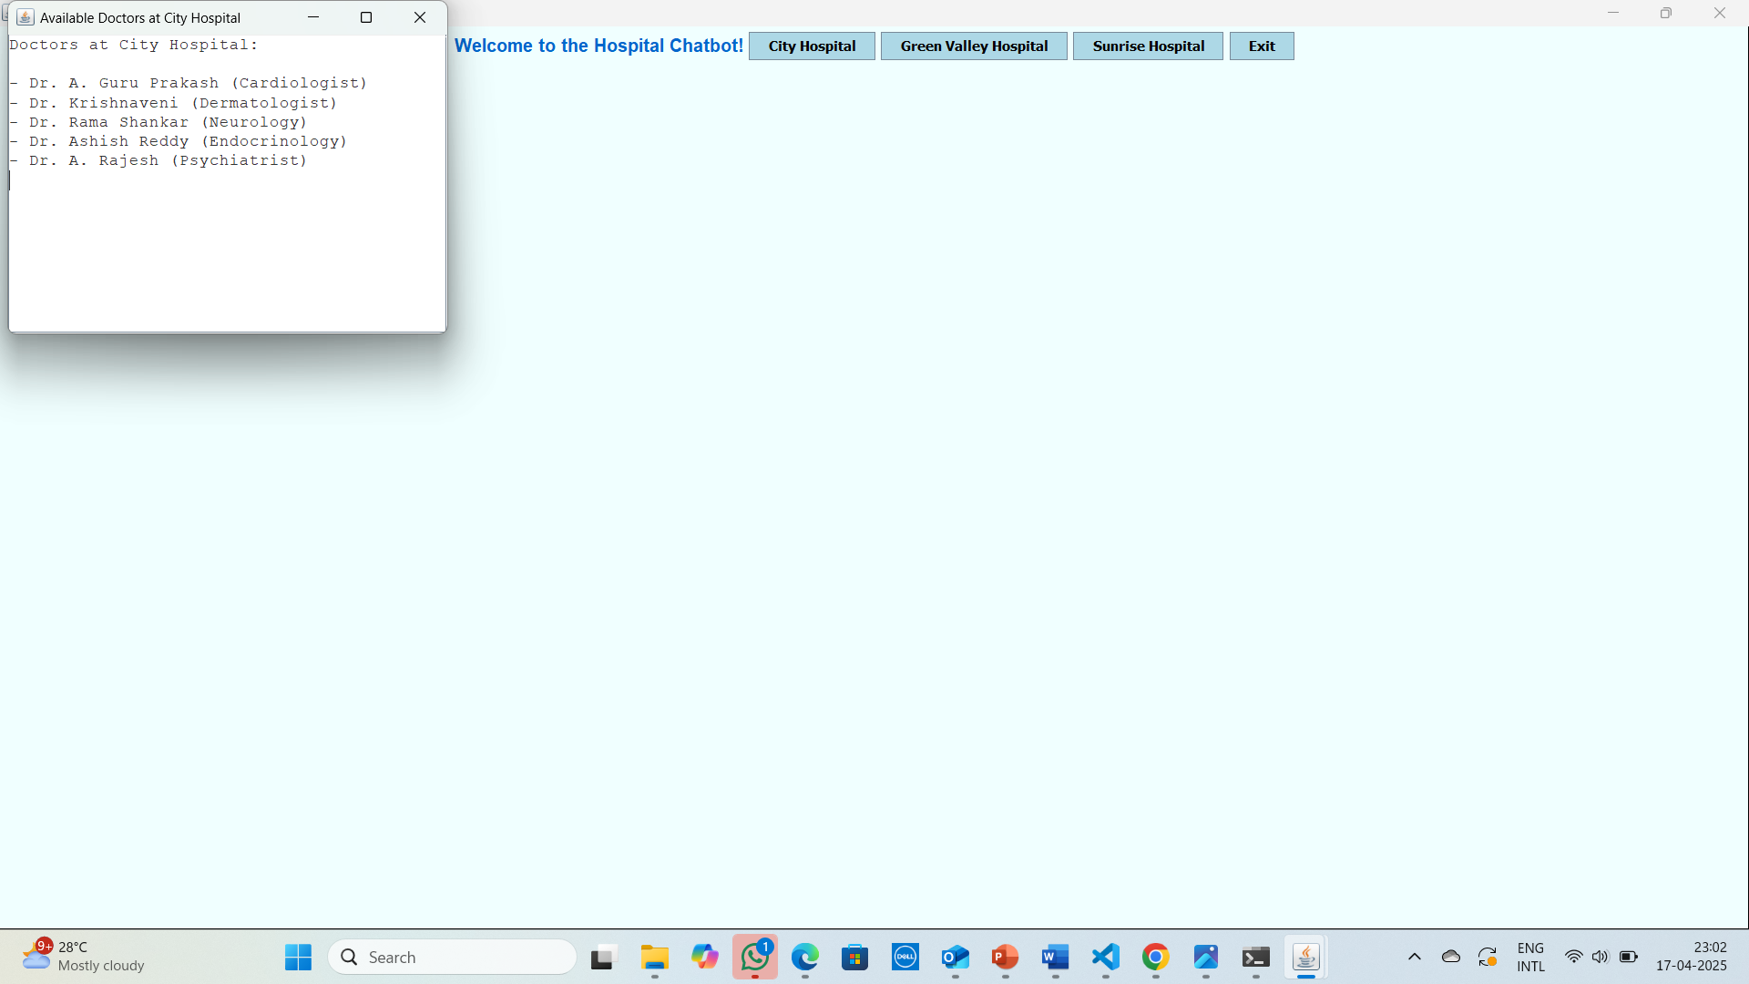

Slide 27
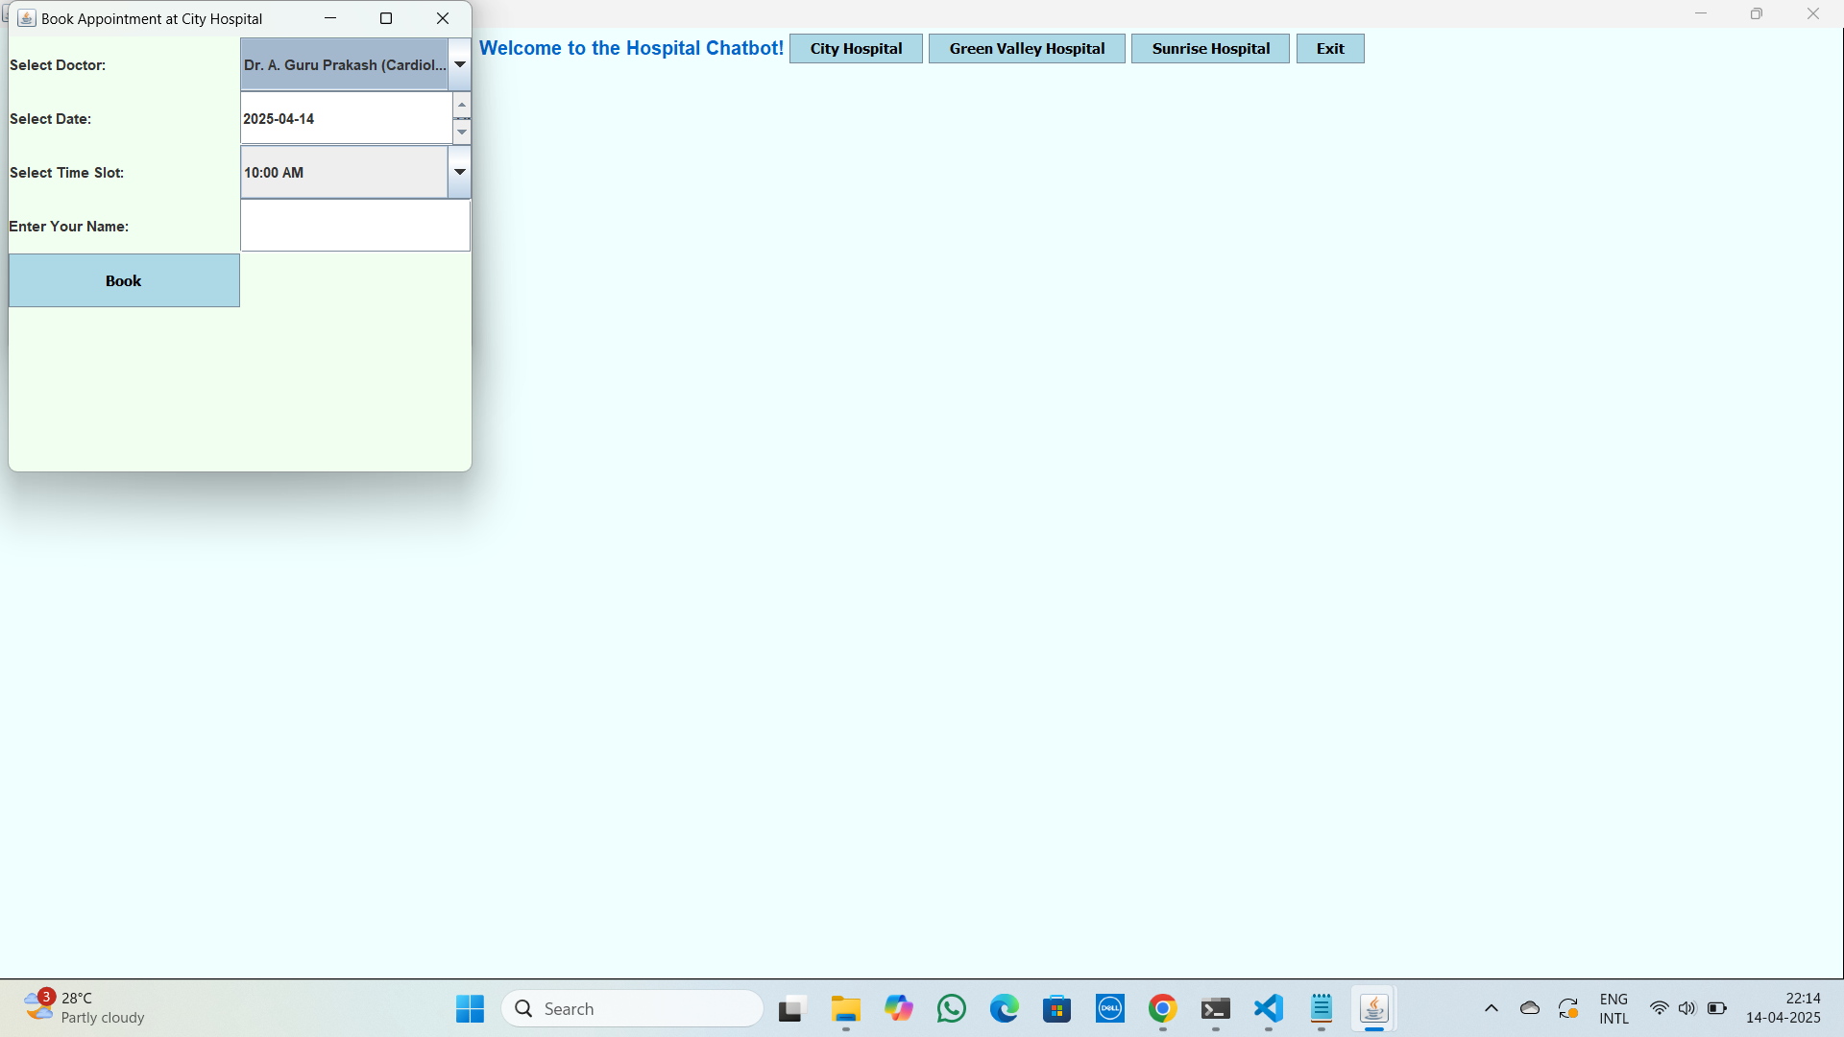

Slide 28
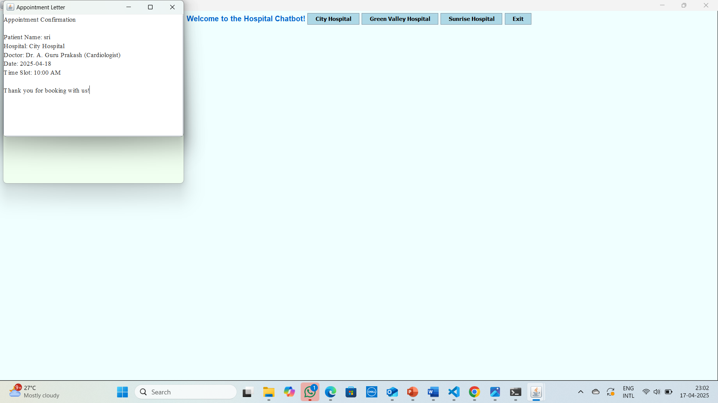

Slide 29
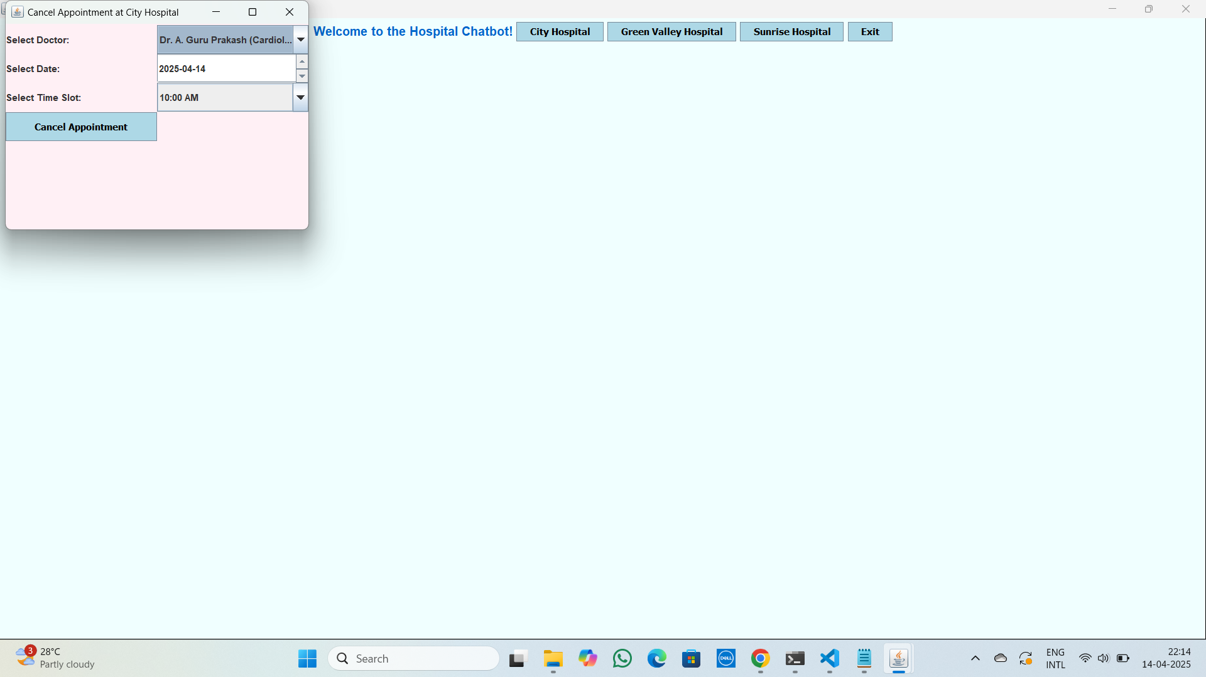

Slide 30
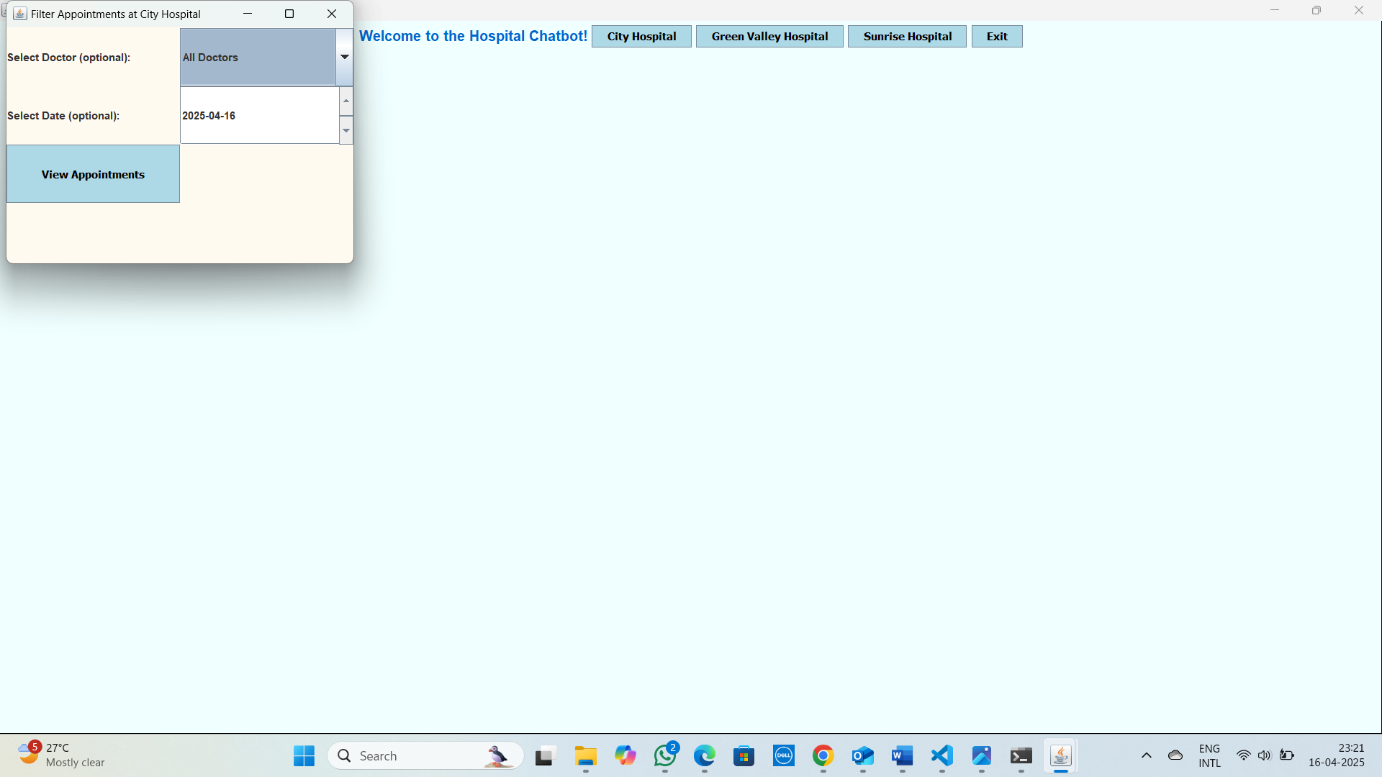

Slide 31
Conclusion & Future Scope
1.Efficiently manages hospital appointments through a user-friendly chatbot.
2.Prevents double bookings with validation checks for smooth scheduling.
3.Enhances user experience with real-time doctor filtering and appointment confirmation.
4.Future scope: Integration with patient medical history and health records.
5.Can be extended to support multilingual chatbots and real-time emergency response features.

Slide 32
First Review Questions and Answers
1.Why use this system when many hospital websites already exist? Ans: This system provides a single interface for multiple hospitals, so users don’t need to visit separate websites to check doctor availability.
2. What if some hospitals do not allow appointment cancellations? Ans: The cancellation option is enabled only for hospitals that allow cancellations, ensuring hospital-specific rules are followed.
3. How can users view their booked appointments? Ans: All booked appointment details are sent to a dedicated interface,
where users can easily check and manage them.

Slide 33
References
1.Oracle Java Swing Documentation https://docs.oracle.com/javase/8/docs/technotes/guides/swing/
2.Oracle Java Platform SE 8 API Specification https://docs.oracle.com/javase/8/docs/api/
3.GeeksforGeeks – Java Swing Tutorial. https://www.geeksforgeeks.org/java-swing/
4.GeeksforGeeks – Event Handling in Java https://www.geeksforgeeks.org/event-handling-in-java/
5.TutorialsPoint – Java Swing https://www.tutorialspoint.com/swing/index.htm

Slide 34
Thank you

